Slide 1



PR-report
24th International Caspian Oil & Gas Exhibition
24th International Caspian Oil & Gas Conference
7th Caspian International Power and Alternative Energy Exhibition
Prepared by PR-assistant
Shovkat Hasanova

Slide 2
PR report
Press Conference
Media Monitoring
Newspapers
Opening Ceremony
Magazines
TV
Internet Portals
VIP Tour

Slide 3
Statistics
Of the CaspianOil&Gas, CaspianPower & CaspianOil&GasConference :
222 articles were published in 28 Newspapers and 10 Magazines
2125 news were published in 154 Internet Portals
8 TV channels showed the video about the exhibitions 59 times in daily news
6 Radio channels voiced advertising 36 times

Slide 4
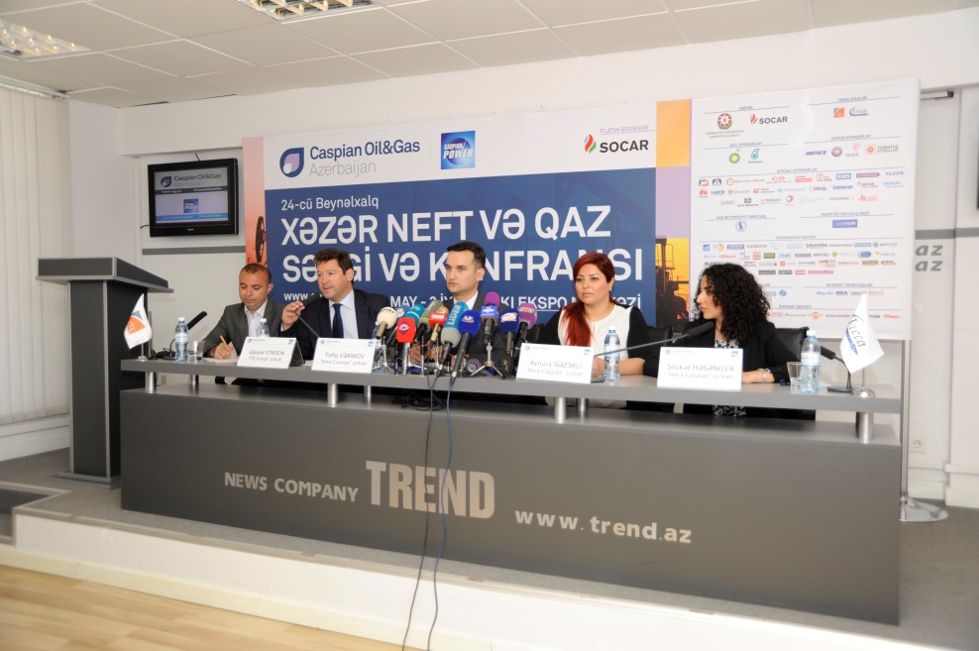
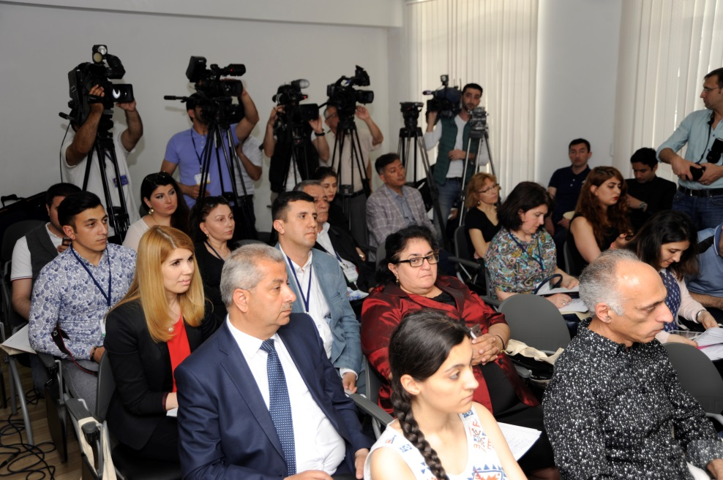
Press Conference
The press conference dedicated to the opening of the 24th International Exhibition and Conference Caspian Oil & Gas 2017 and 7th Caspian International Power and Alternative Energy, Caspian Power 2017 Exhibition were held on 30 May at 12:00 a.m. at the Press Center of Trend News Company.
The press conference was attended by Mr. Edward Strachan, Regional Director of ITE Group, Mr. Tofig Karimov, Manager of Caspian Oil & Gas Exhibition and Mrs. Aynura Nazarli, Manager of Caspian Oil & Gas Conference.
43 media representatives attended the press-conference from AzTV, APA, AzerTag, CBC, Lider TV, Salamnews, Xezer TV, Trend and other news agencies. During the press conference, journalists were informed of the exhibitors and statistics of the exhibitions, the program of the traditional Caspian Oil and Gas conference and sponsors.

Slide 5
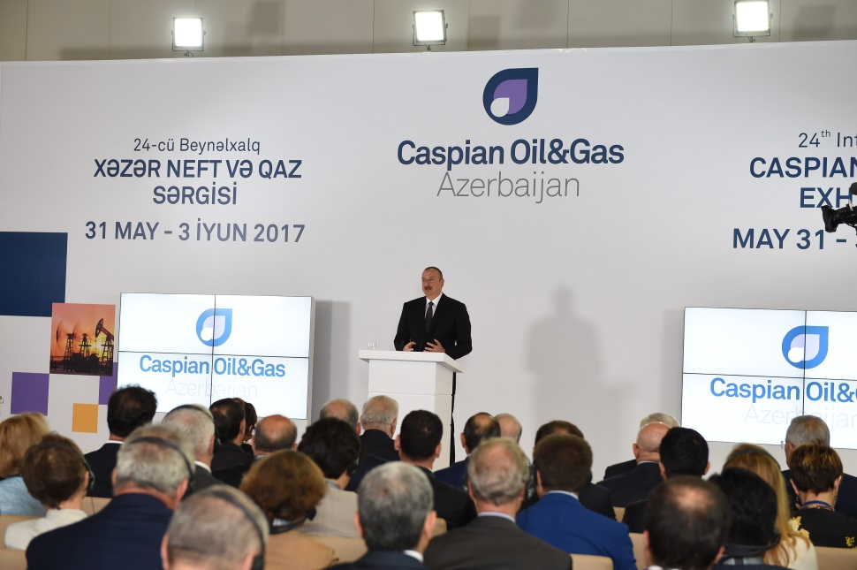
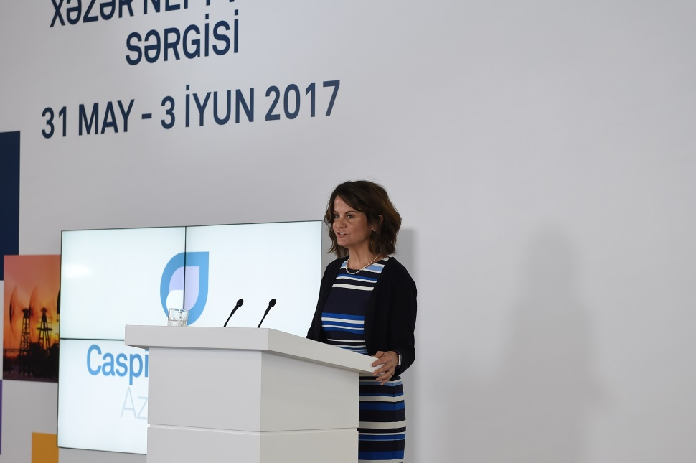
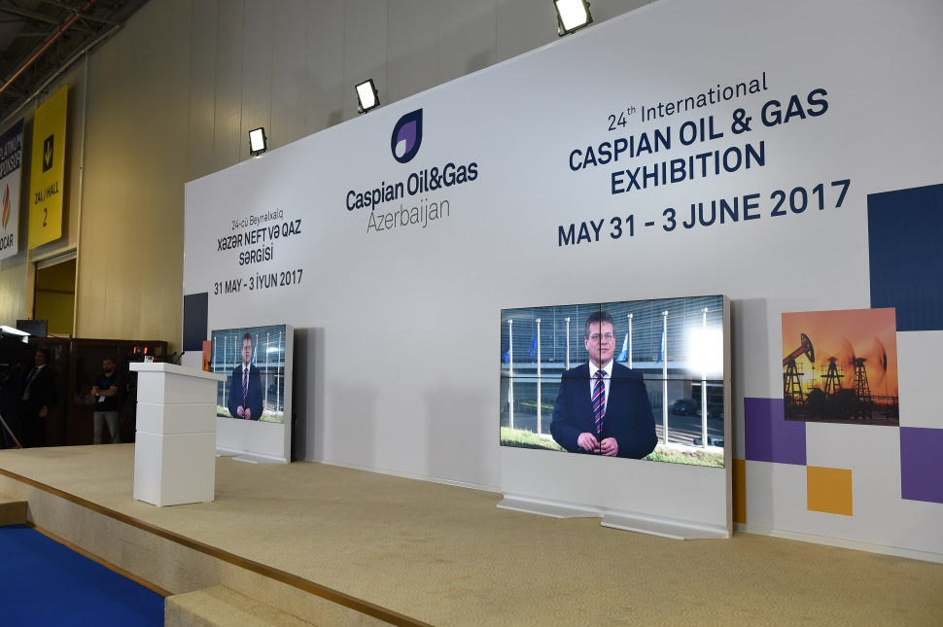
Opening Ceremony
Opening Ceremony dedicated to the 24th International Caspian Oil&Gas Exhibition and Conference and 7th Caspian International Power and Alternative Energy Exhibition was held on May 31st at 09:30 at Baku Expo Center.

Slide 6
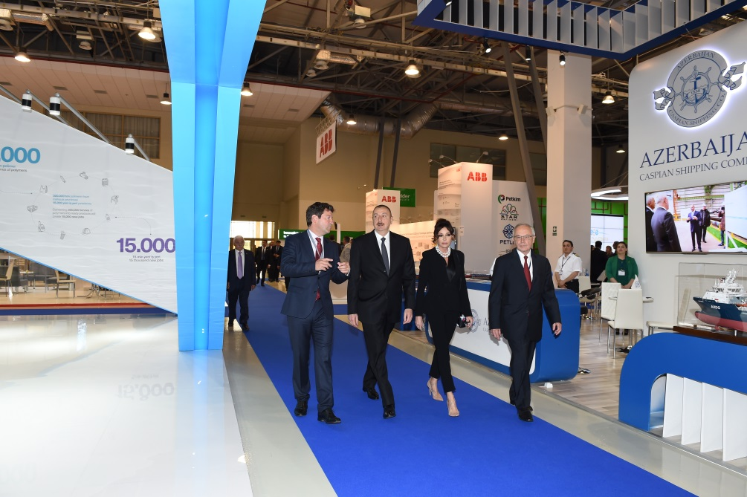
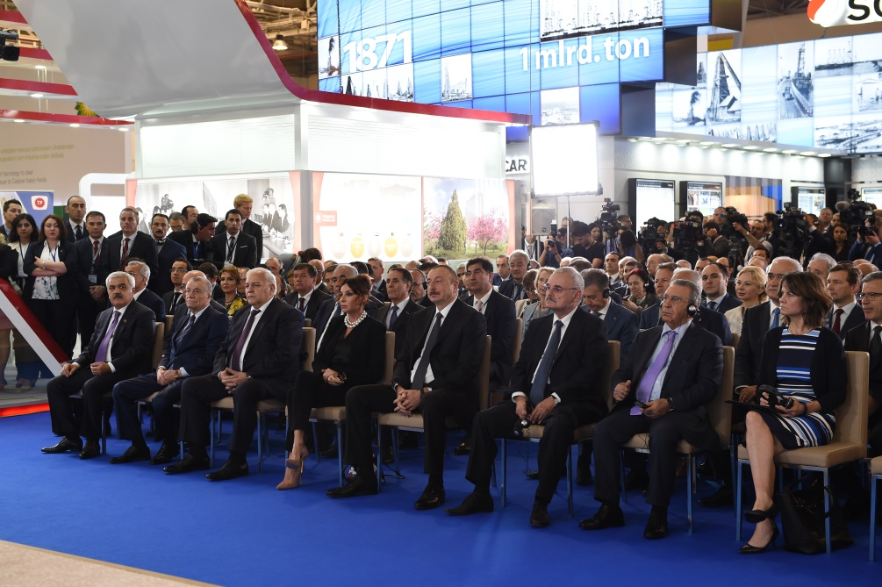
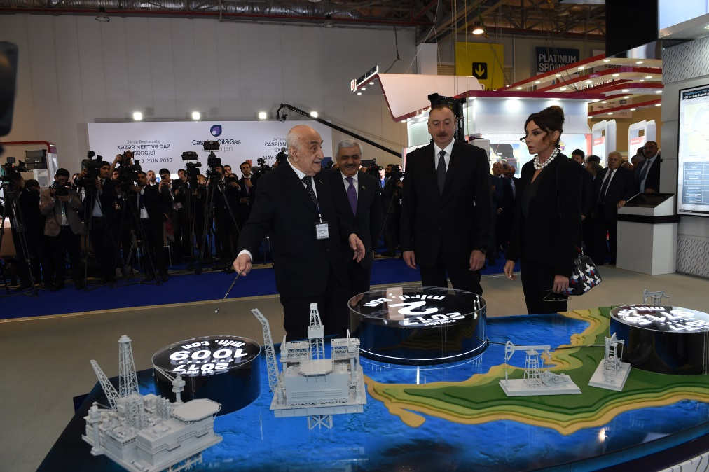
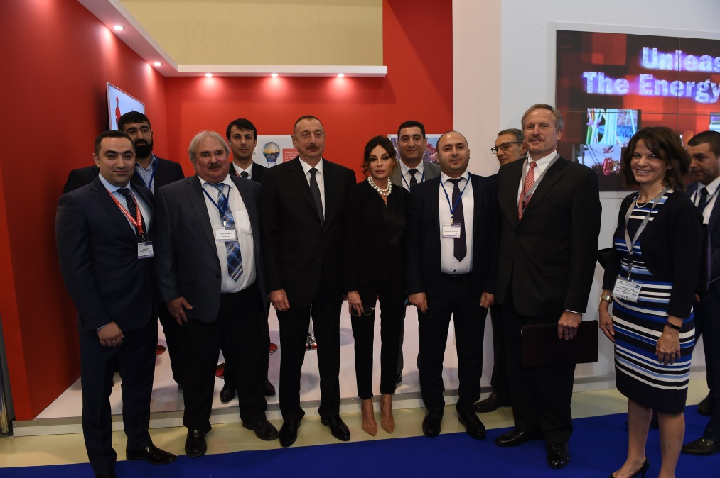

Slide 7
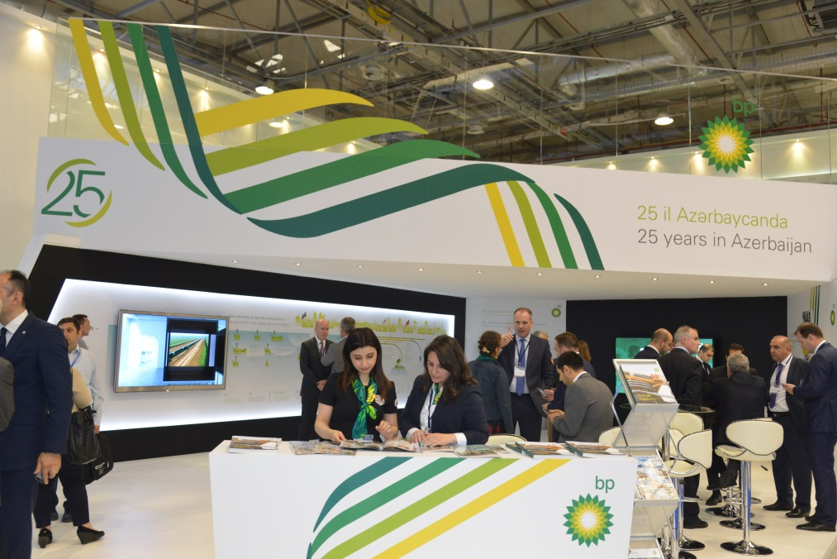
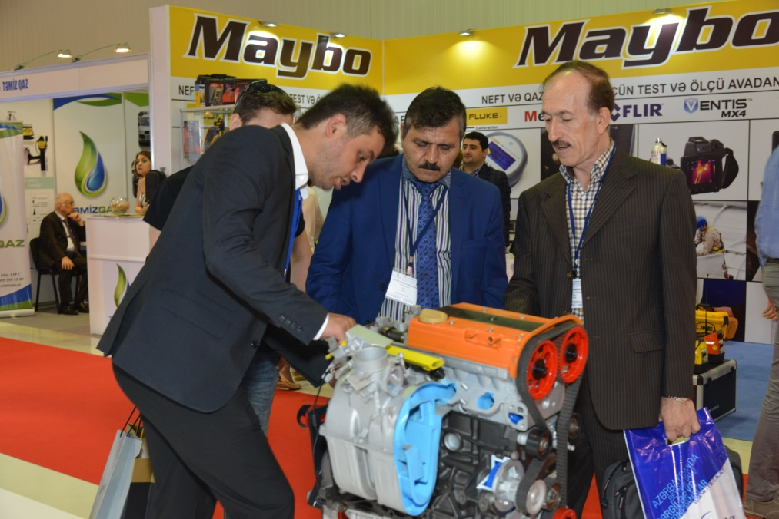
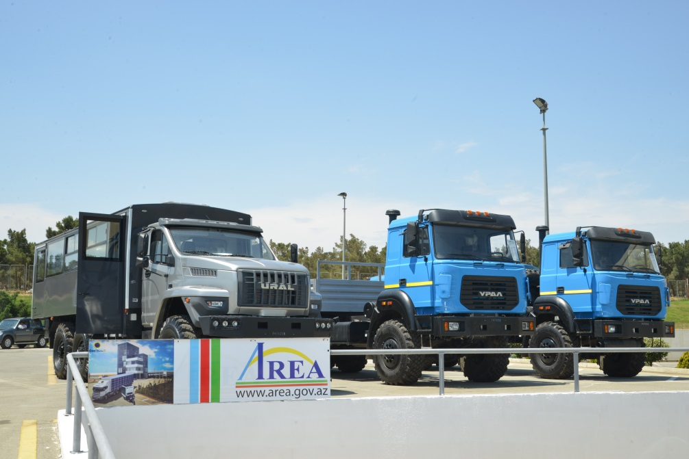
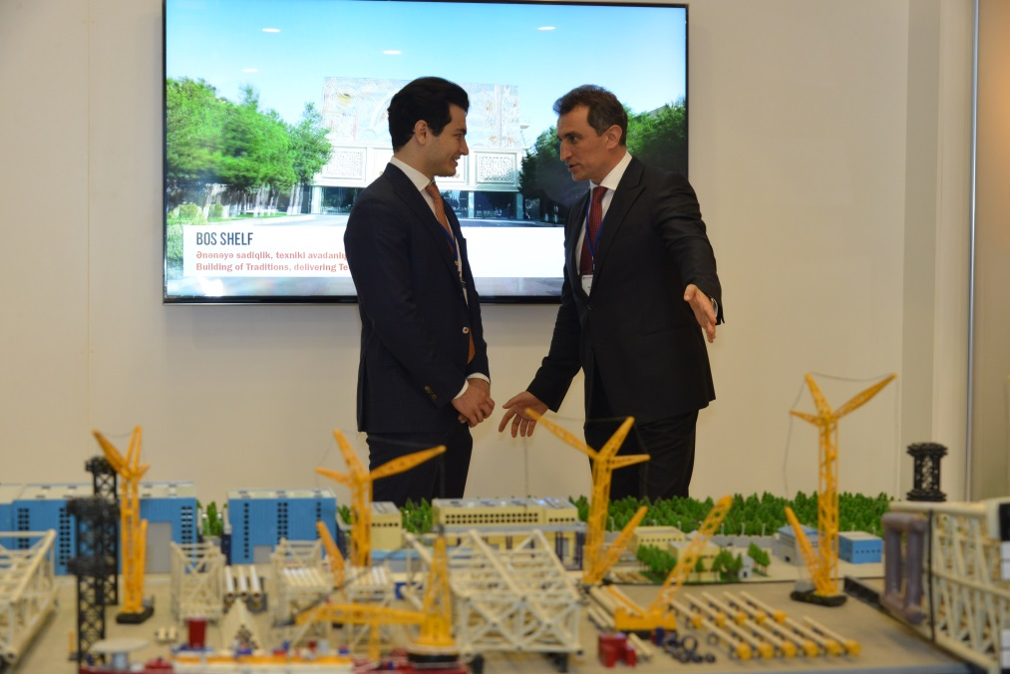

Slide 8
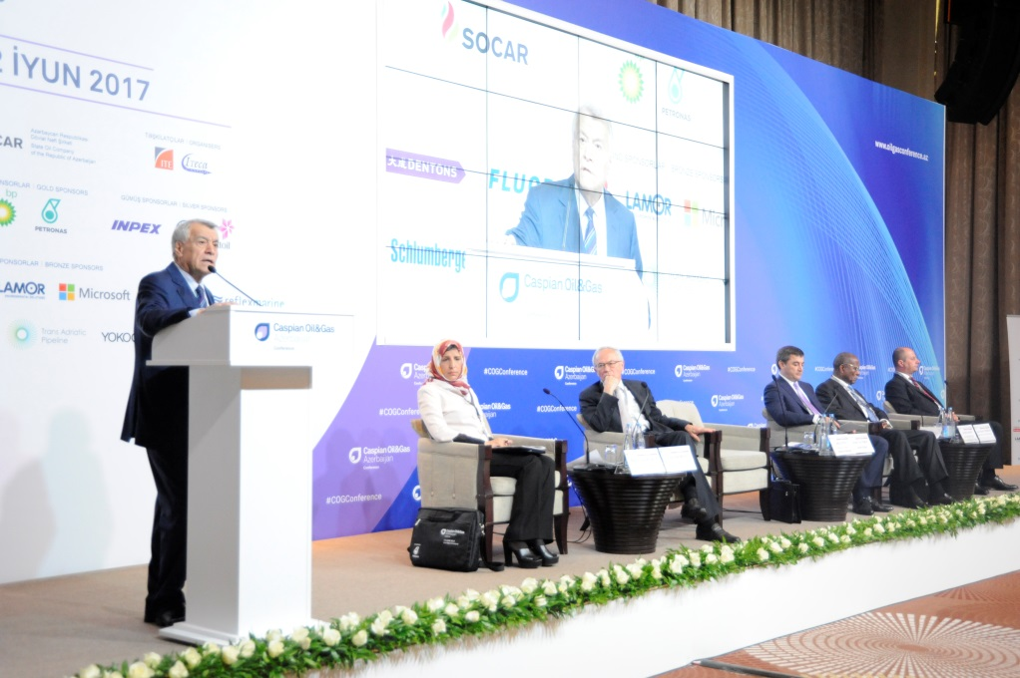
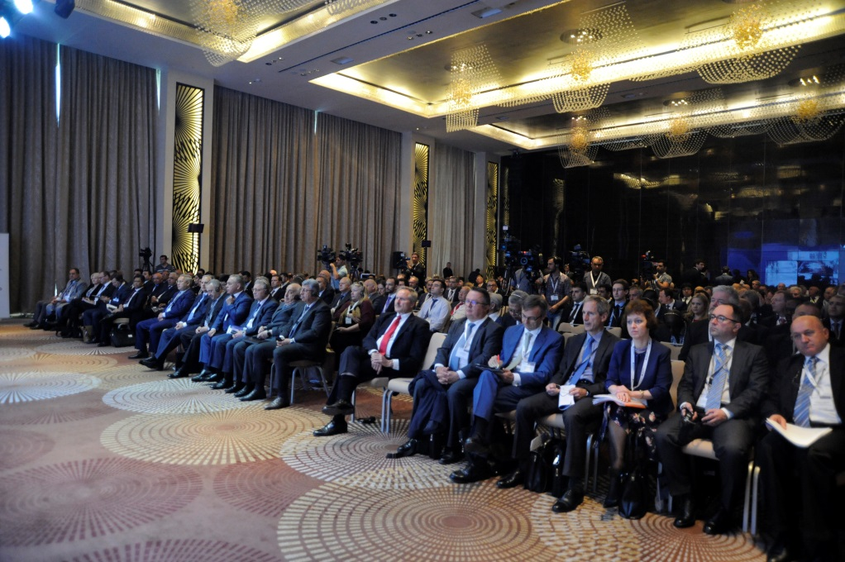
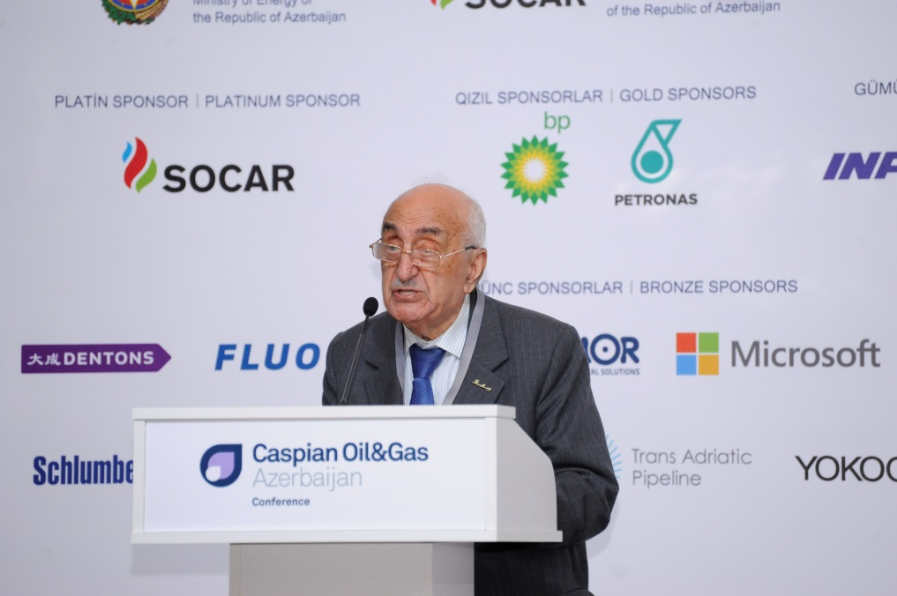
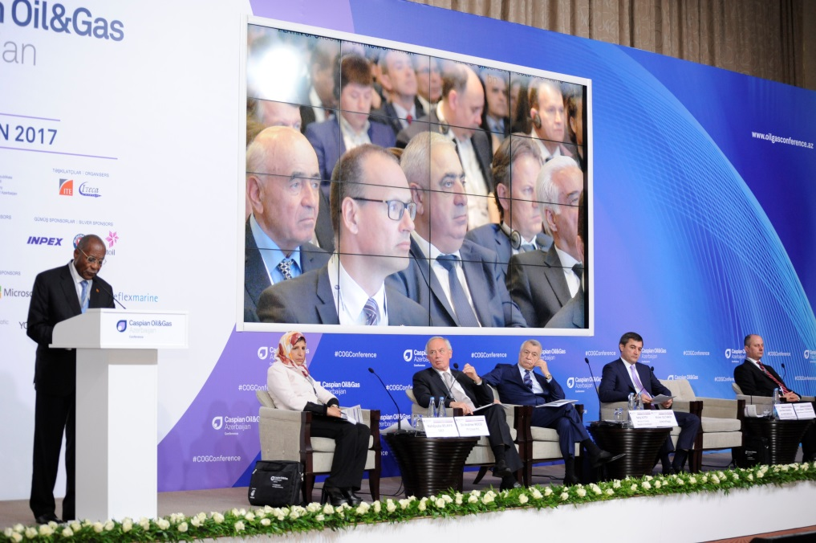

Slide 9

Media Monitoring

Slide 10

Newspapers
Azerbaycan
Azad Azerbaycan
Azerbaycanskiye Izvestiya
Bizim Yol
Baki Xeber
Iki sahil
Baki Xeberi
Bizim Yol
Echo
Edalet
Nedelya
Novoye Vremya
Paralel
Respublika
Ses
Unikal
Kaspi
Vishka
Palitra
Iqtisadiyyet
Ekspress
Ejednevnie novosti
Hefte ichi
Olaylar
Uch Noqte
Xalq Cebhesi
Xalq qazeti
Yeni Azerbaycan
Yeni Musavat
525-ci qazet

Slide 11

Magazines
Azeri Observer
AzeriNews
Caspian Energy
Consulting & Business
Enerqo Ekspert
Enerqo-info
Oil & Gas Kazakhstan
TEAS
Vremya koltyubinqa
World Economics

Slide 12
TV monitoring
Date | Time | Channels
01.06.2017 | 12:00 | ITV
01.06.2017 | 13:00 | ARB
01.06.2017 | 13:00 | Lider
01.06.2017 | 14:00 | CBC
01.06.2017 | 14:00 | AzTV
01.06.2017 | 15:00 | ATV
01.06.2017 | 17:28 | CBC
01.06.2017 | 17:31 | CBC
01.06.2017 | 17:32 | CBC
01.06.2017 | 19:10 | CBC
02.06.2017 | 12:00 | Xezer
02.06.2017 | 12:00 | CBC
02.06.2017 | 13:00 | Lider
02.06.2017 | 18:18 | CBC
02.06.2017 | 20:30 | AzTV
03.06.2017 | 17:09 | CBC
03.06.2017 | 17:25 | CBC
04.06.2017 | 20:10 | AzTV
04.06.2017 | 21:30 | Xezer
30.05.2017 | 13:00 | Lider
30.05.2017 | 13:30 | ARB
30.05.2017 | 14:00 | CBC
30.05.2017 | 15:00 | ATV
30.05.2017 | 17:01 | CBC
30.05.2017 | 17:33 | CBC
30.05.2017 | 17:38 | AzTV
30.05.2017 | 19:40 | Lider
30.05.2017 | 21:19 | ITV
31.05.2017 | 12:00 | CBC
31.05.2017 | 12:00 | Xezer
31.05.2017 | 13:00 | Lider
31.05.2017 | 13:30 | ARB
31.05.2017 | 14:00 | Space
31.05.2017 | 15:00 | ATV
31.05.2017 | 17:01 | CBC
31.05.2017 | 19:01 | Lider
31.05.2017 | 19:02 | ARB

Slide 13
Radio monitoring
Date | Time | Channels
01.06.2017 | 10:00 | Asan Radio
01.06.2017 | 11:00 | Araz Radio
01.06.2017 | 11:00 | Burc FM
01.06.2017 | 12:00 | Antenn FM
02.06.2017 | 12:00 | Araz Radio
02.06.2017 | 12:00 | Burc FM
02.06.2017 | 12:00 | Lider
02.06.2017 | 13:00 | Araz Radio
02.06.2017 | 14:00 | Araz Radio
30.05.2017 | 12:00 | 106.3 FM
30.05.2017 | 12:00 | Antenn
30.05.2017 | 12:00 | Lider
30.05.2017 | 13:00 | Asan Radio
30.05.2017 | 19:00 | Lider
31.05.2017 | 10:00 | 106.3 FM
31.05.2017 | 10:00 | Asan Radio
31.05.2017 | 10:00 | Lider FM
31.05.2017 | 11:00 | 106.3 FM
31.05.2017 | 11:00 | Antenn FM
31.05.2017 | 11:00 | Antenn FM
31.05.2017 | 11:00 | Asan Radio
31.05.2017 | 11:00 | Burc FM
31.05.2017 | 11:00 | Burc FM
31.05.2017 | 11:00 | Lider FM
31.05.2017 | 11:00 | Araz Radio
31.05.2017 | 12:00 | Antenn FM
31.05.2017 | 12:00 | Asan Radio
31.05.2017 | 13:00 | 106.3 FM
31.05.2017 | 13:00 | Asan Radio
31.05.2017 | 13:00 | Burc FM
31.05.2017 | 13:00 | Lider FM
31.05.2017 | 14:00 | Burc FM
31.05.2017 | 15:00 | Asan Radio
31.05.2017 | 15:00 | Burc FM
31.05.2017 | 16:00 | Araz Radio
31.05.2017 | 16:00 | Lider FM

Slide 14

Watch us on YouTube channel:
https://www.youtube.com/user/ItecaCaspian

Slide 15


Total number of COG 2899
Total number of COGConference 1738

Slide 16



SEE YOU IN 2018!

